Slide 1
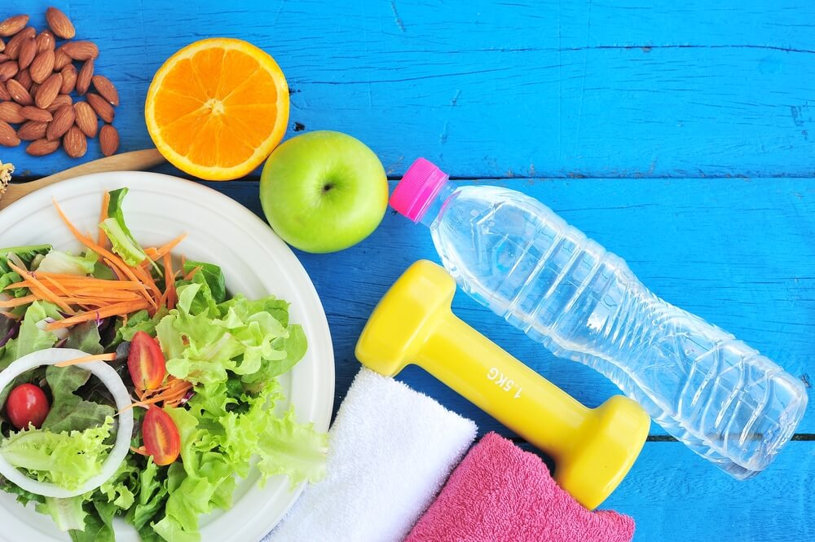
CSE 299 Development Progress Week : 08
Dietary : a Cloud based Nutriment & Fitness Assistant
(fact-based) Android App for Bangladeshi Youths.
Phone
Email
Presenting By : Group 1
Date : 10.09.2020
Website

Slide 2
Agenda
Preview
Development Progress
Comparison
Conclusion
Q/A Segment

Slide 3


Preview
Fitness Assistant (Regular Life Based)
Trained agent for Chatbot (User Assistant)
Preprocess dataset (food recommendation)
3

Slide 4

This week
Development
Progress
Development Progress
4

Slide 5
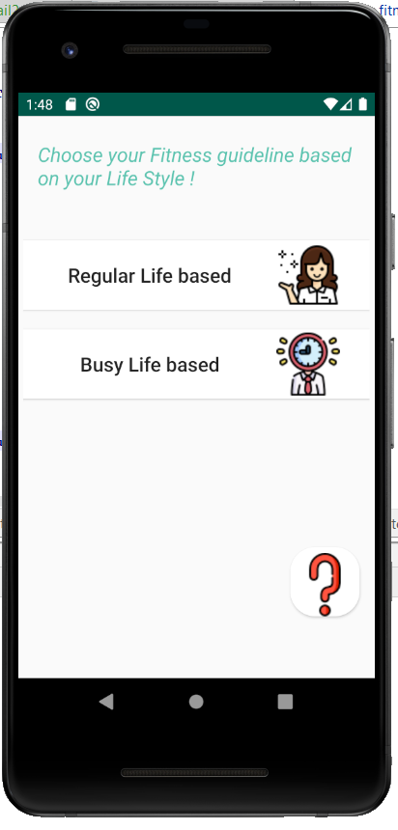
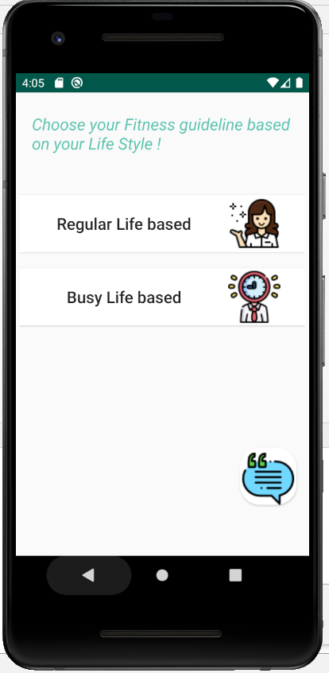
Correction from last week
5

Slide 6
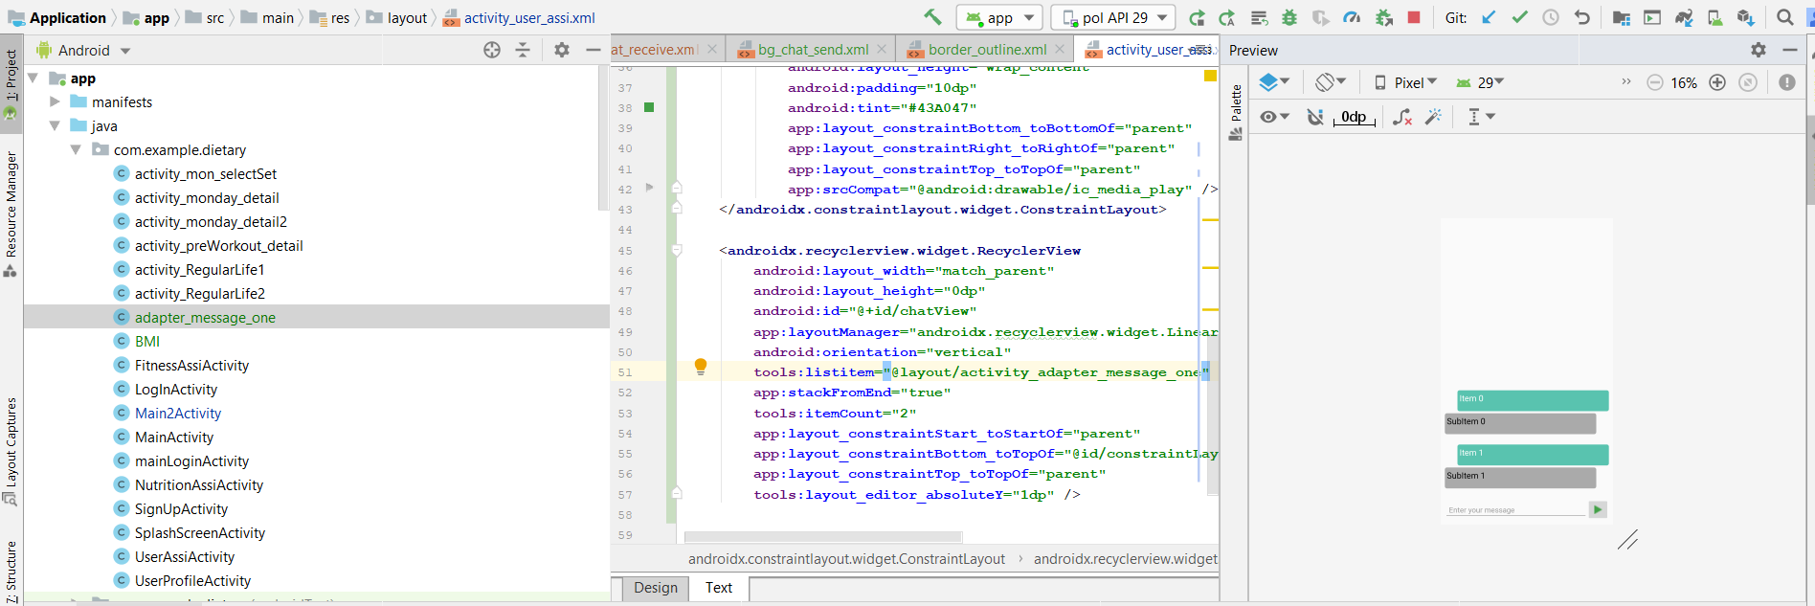
Chatbot implementation
6

Slide 7



Nutrition Assistant
Nutrition
Assistant
BMI Calculator
Food Recommendation
7

Slide 8

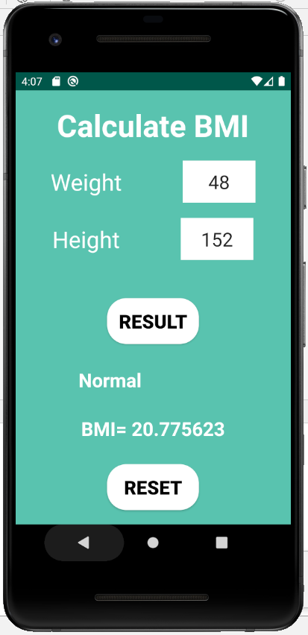
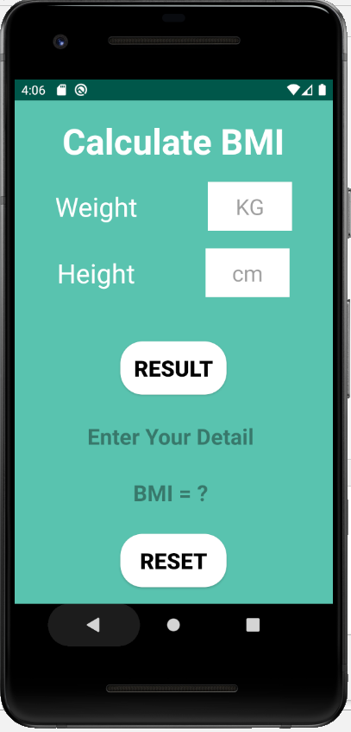
BMI Calculator
Nutrition
Assistant
8

Slide 9

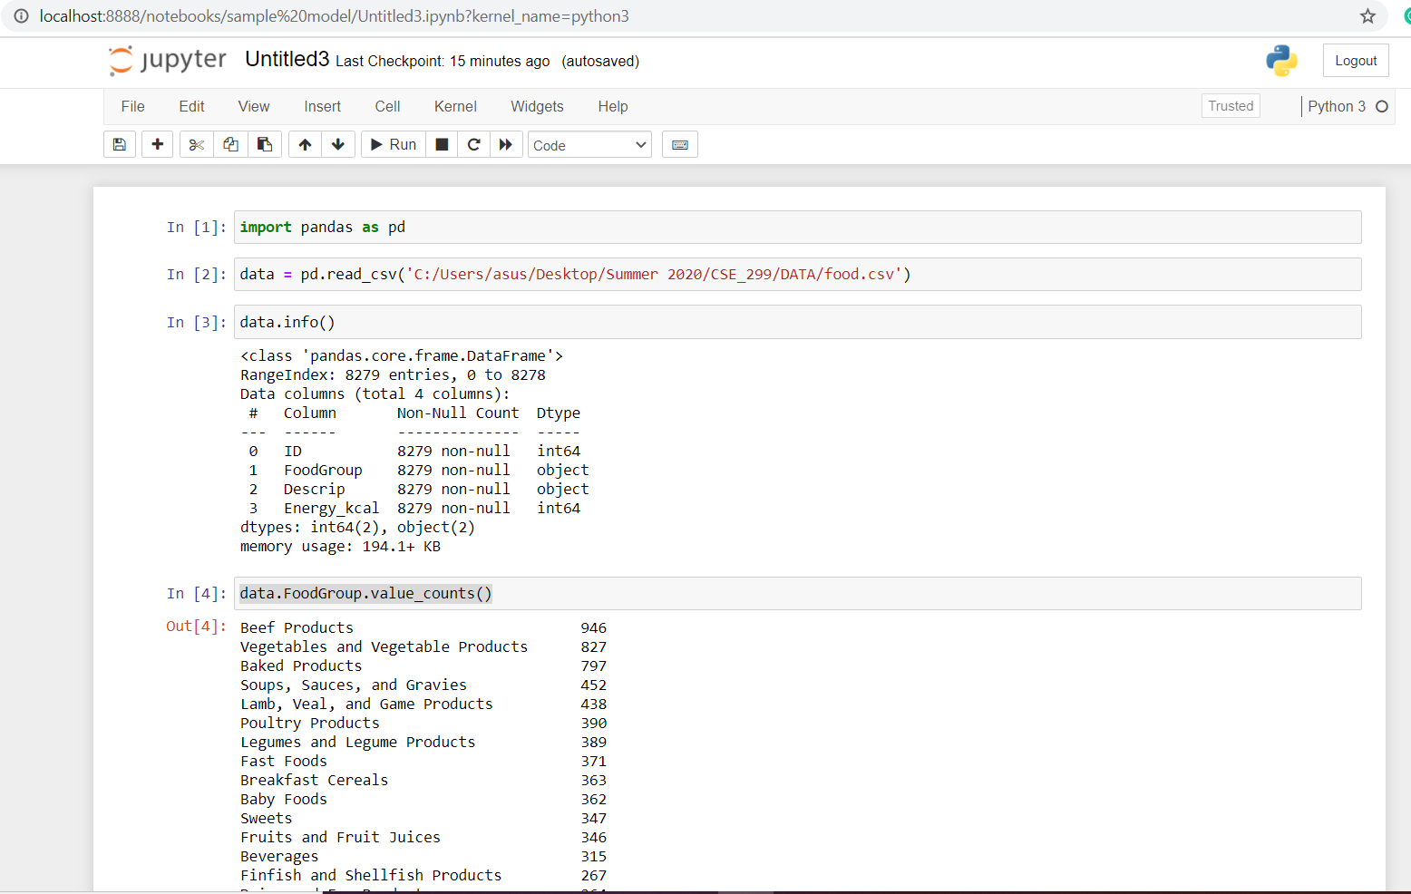
Model Training
9

Slide 10

Comparison
Week-1 | Week-2 | Week [ 3 - 7 ]
Android app : Dietary
Features : | Updated Features :
Nutrition Assistant : BMI calculator, Food recommender using BMI. | *Food recommendation using Machine Learning. *Algorithm : KNN
Fitness Assistant : life style based fitness guideline; like regular or busy lifestyle. | --------------------
User Assistant : user manual & chatbot (basic Q/A on app operating). | --------------------
Authentication : using Firebase | --------------------
worked parallel
with
all
features

Slide 11


Comparison
Week-8
Done | On progress
User Interface | Marge overall app.
Authentication
Nutrition Assistant : BMI Calculator | Nutrition Assistant : Food recommender
Faintness Assistant : Regular life based Busy life based
User Assistant : User manual | User Assistant : Chatbot
11

Slide 12


Conclusion
That’s all for today’s discussion.
We really hope to able to end our task on time.
12

Slide 13
Name
Phone
Email
Website

Slide 14
Questions?
Or
Name
Suggestion!
Phone
Email
Website

